Slide 1
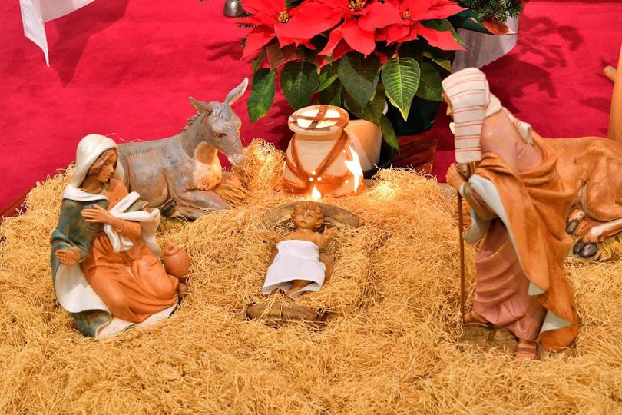
photo by Atsushi Takaki

Slide 2
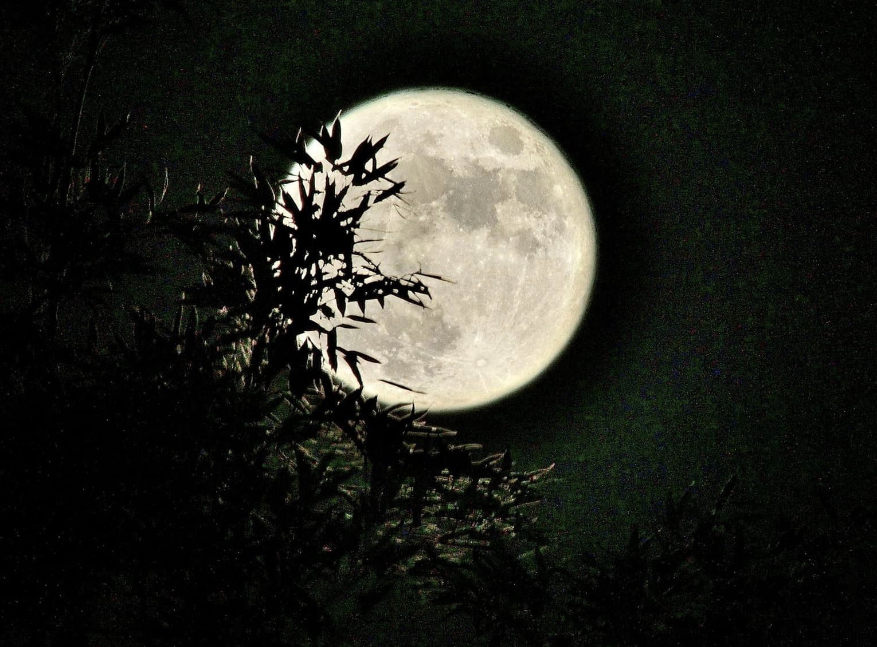
photo by Atsushi Takaki

Slide 3
photo by Atsushi Takaki

